Slide 1




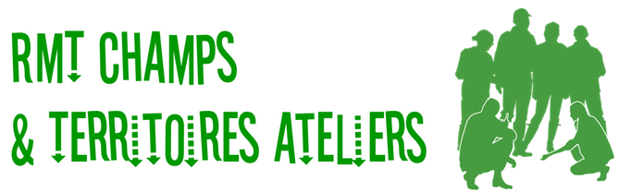







The ’Dashboard’ as a tool for monitoring the improvement of soil fertility and supporting agroecological transitions
Anne-Sophie Perrin, Stéphane Cadoux, Michael Geloen and Joséphine Peigné
as.perrin@terresinovia.fr, s.cadoux@terresinovia.fr
Partners:

Slide 2
Outline
Context, aim and approach (= why, how and what of the dashboard)
Results (= 1 example of design and use of a dashboard)
Discussion & conclusion (link between dashboard and soil fertility)

Slide 3
Context, aim and approach

Slide 4
The necessary agroecological transition
Agroecological transition is necessary to reconcile agricultural productions and the environment (Zhang et al. 1997)
Soil fertility is one of the key ecosystem services necessary to agroecological systems (Duru et al. 2015)
Complex to address soil fertility and agroecological transitions due to biological interactions & the need for systemic approaches…
=> New approaches and tools are needed

Slide 5
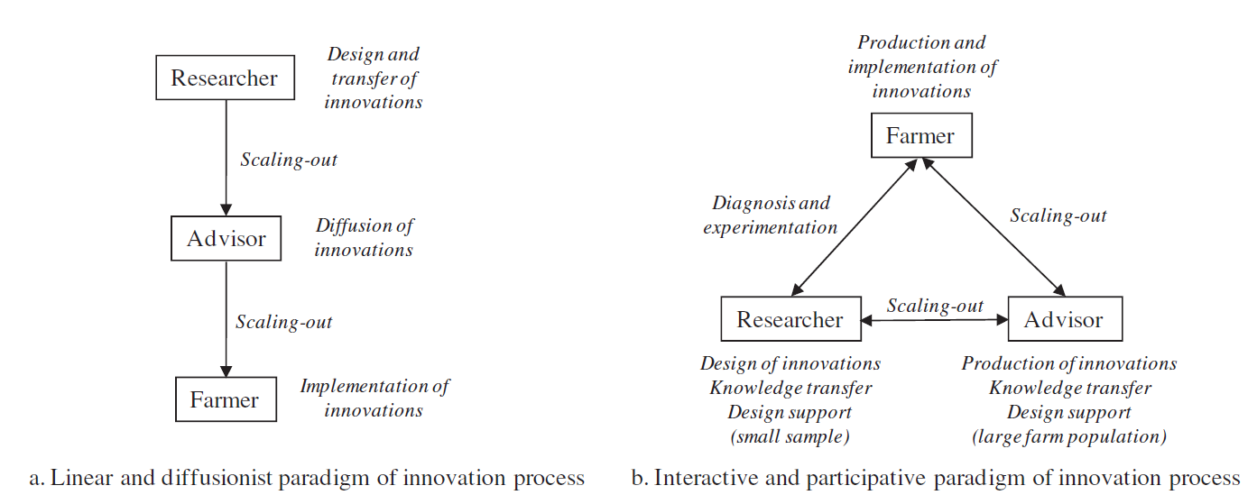
What approach and tools are needed?
Historical <-
-> More adapted to support transitions
Le Gall et al. 2010
  Generative experiments rather than controlled experiments (according to Ansell & Bartenberger 2016)
  Design support tools rather than decision-making tools to empower farmers to design their own cropping systems step by step

Slide 6
The Dashboard to facilitate transitions
It has already proved its value by enabling the step-by-step change of practices to improve water quality in a catchment area (Prost et al. 2018) or winter oilseed rape robustness (Cadoux et al. 2018)
Schematic example of design:
1- It focuses on a benefit expected by a (group of) farmer(s)
Final result
2- It sheds light on the ways to achieve the expected result by highlighting key soil/crop states and causal relationships
3- It contains indicators and thresholds to clarify expectations and objectify the evaluation
Key state A
Key state B
Practices A, A’…
Practices B, B’…
Practices C, C’…
4- It encourages the identification of possible practices to implement

Slide 7



The Dashboard to facilitate transitions
Schematic example of use:
Final result
3- Analyzing the result to identify the bottleneck: here improving key state A by reviewing practice A to achieve the final expected result
2- Monitoring to record values of indicators and define satisfaction levels
Key state A
Key state B
Practice
A
Practice
B
Practice
C
1- Choosing practices to implement

Slide 8
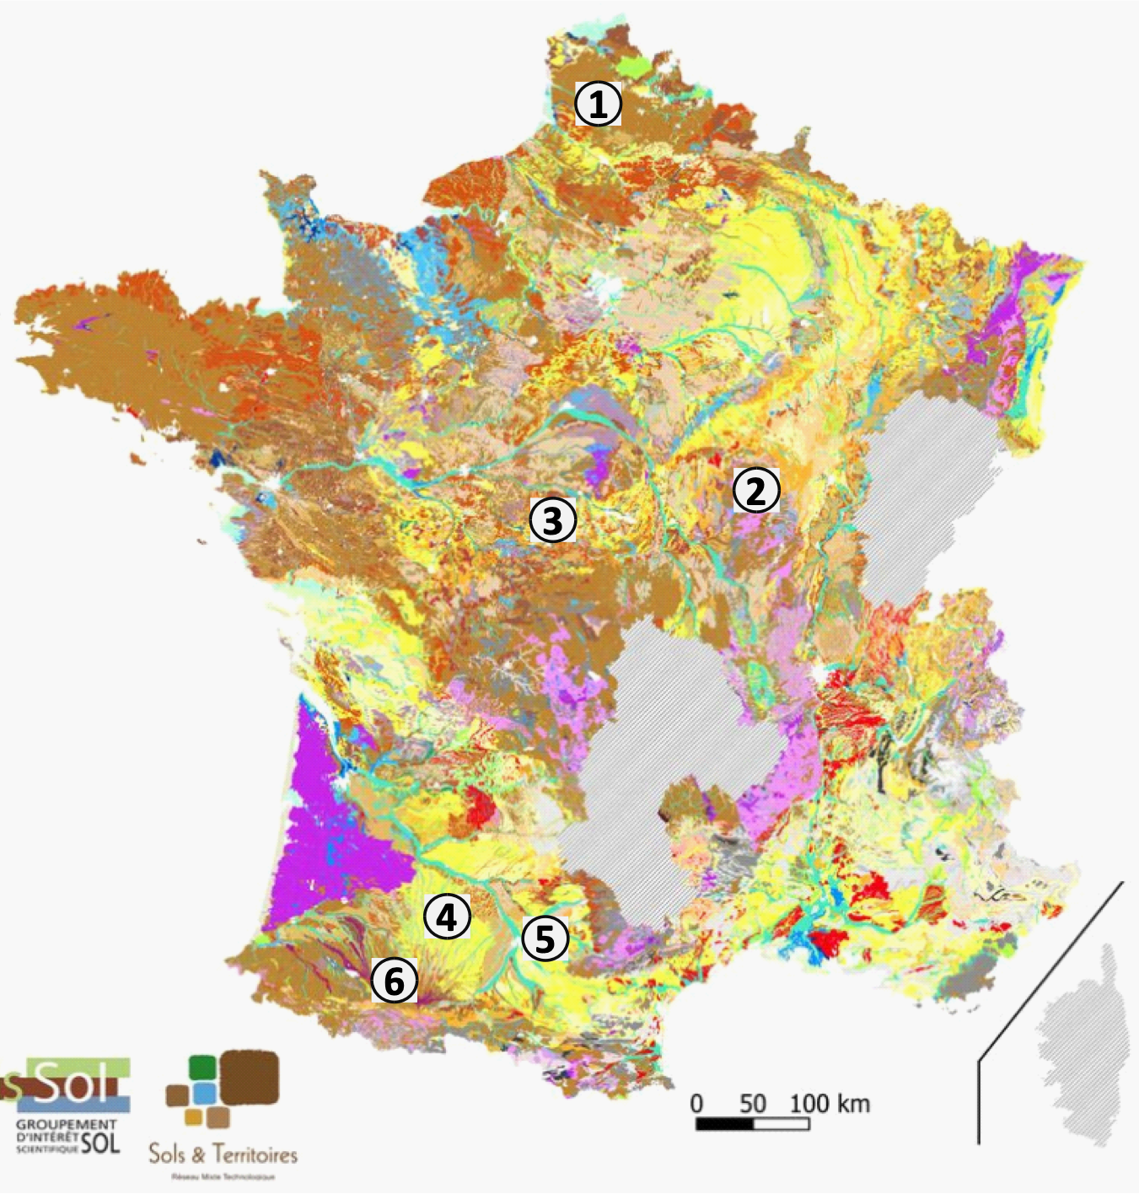
Aim and approach
Aim: to design and implement dashboards for different benefits expected from soil fertility by farmers
Approach:
  Co-design dashboards with researchers and farmers/advisors of 6 farmers’ groups in France
  Continuous improvement of dashboards and farmer’s practices through implementation (monitoring and analyses) in farmers’ fields
Focus on 3 expected benefits:
  Soils providing good nitrogen nutrition to crops (clayey soils with low N mineralization rate)
  Soils with good workability & trafficability in wet conditions (loamy soils)
  Low erosion (slopy clayey soils)

Slide 9
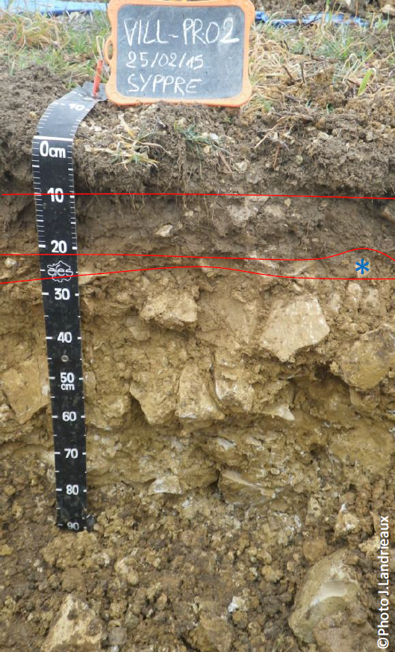
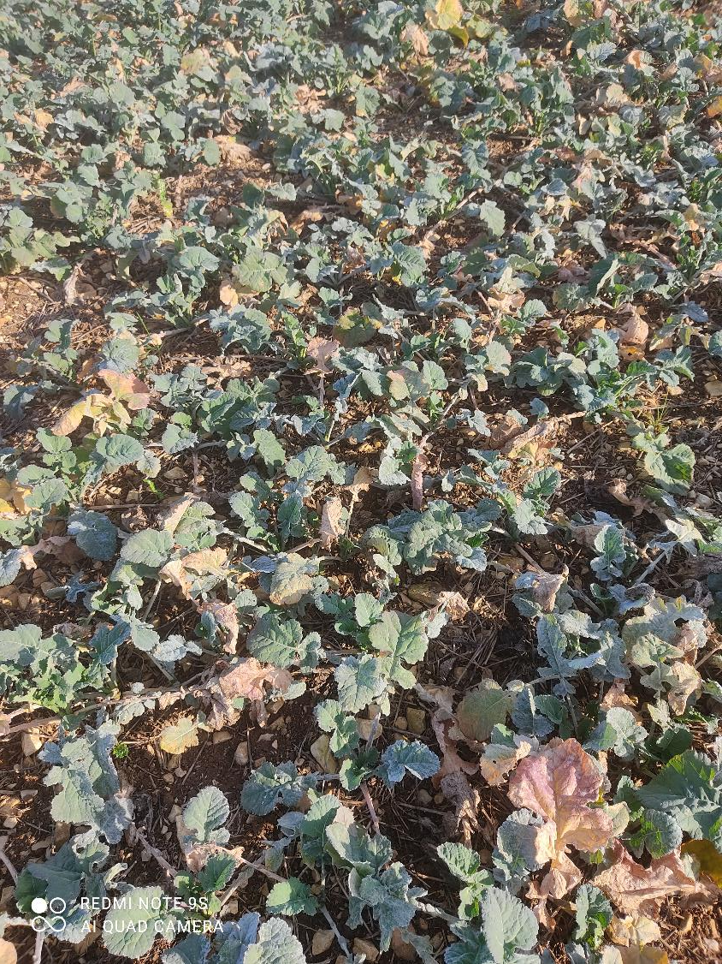
Results
Example of the nitrogen nutrition dashboard
Context of clay-limestone soils with low N mineralization rate leading to high fertilization requirements and/or risk of crop nitrogen deficiency

Slide 10

Nitrogen nutrition dashboard
A soil providing good nitrogen nutrition to crops
Visual N deficiency of rapeseed in autumn
no |  | strong
Soil with high N supply
Soil allowing non-limiting rooting to maximize N capture
Taproot length before winter (cm)
>15 |  | <10
Derived from SOM
N release from residues of the preceding crop
N release from residues of the cover crop
N release from humified organic matter
High biomass
Low C/N
High C stock with high proportion of active OM
Non-limiting Temp. and moisture
Non-limiting
soil pH
Non-limiting biological activity
Derived from residues
C/N
<15 |  | >20
Biom. (t.ha-1)
>3 |  | <1
pH
>7.5 |  | <6
Good soil structure
Cultural practices to be implemented ?
Soil structure score
<3 | 3 | >3

Slide 11
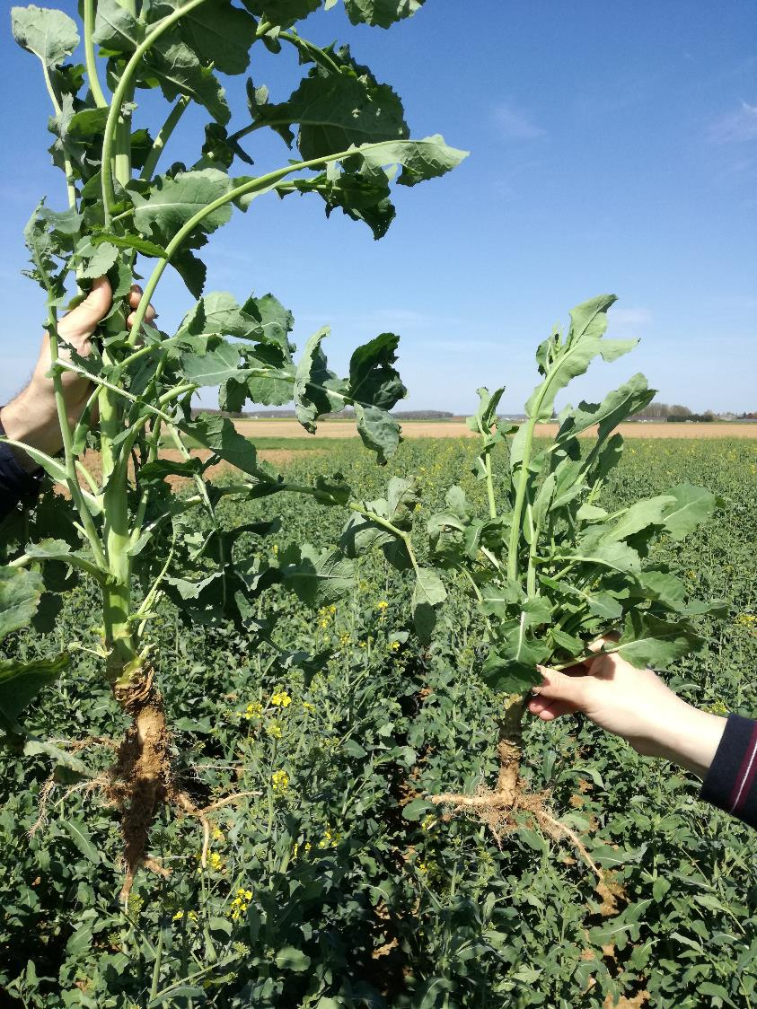
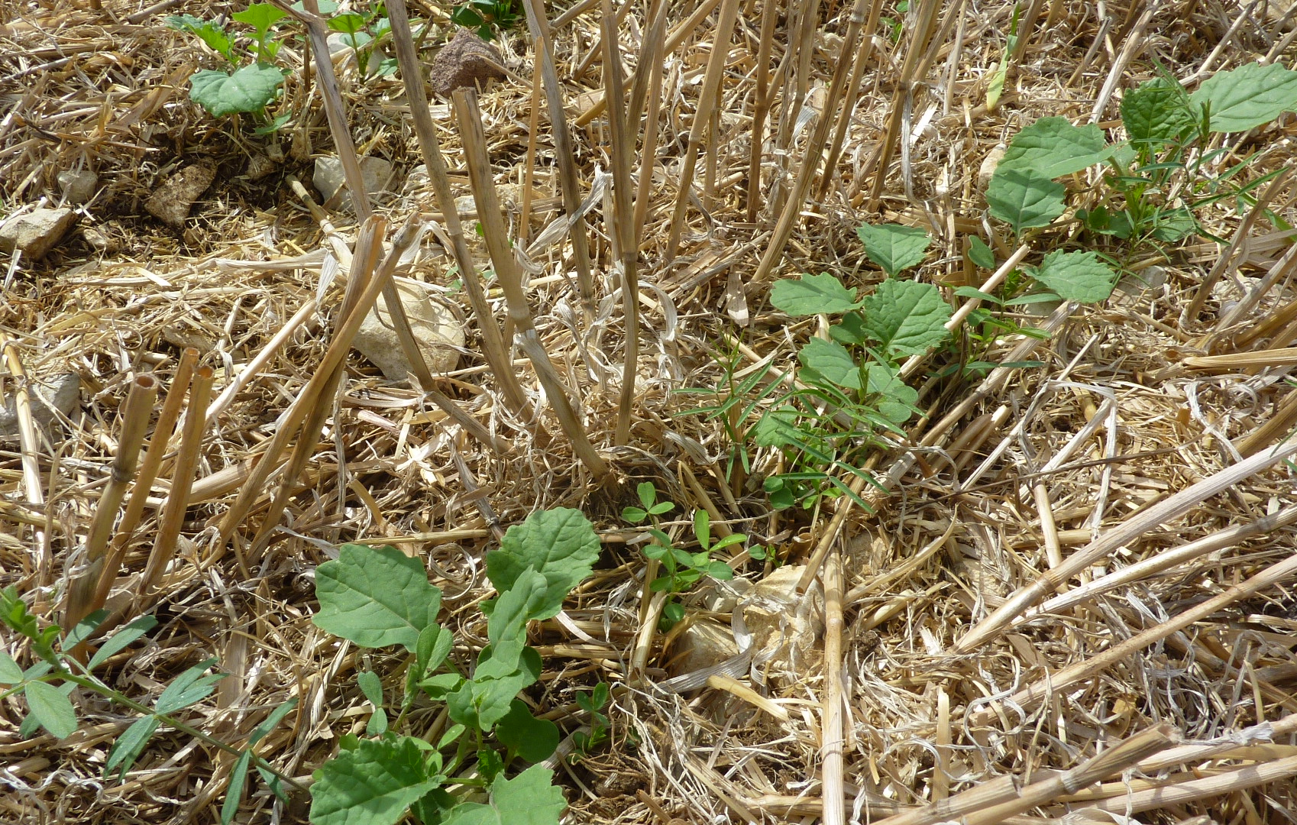
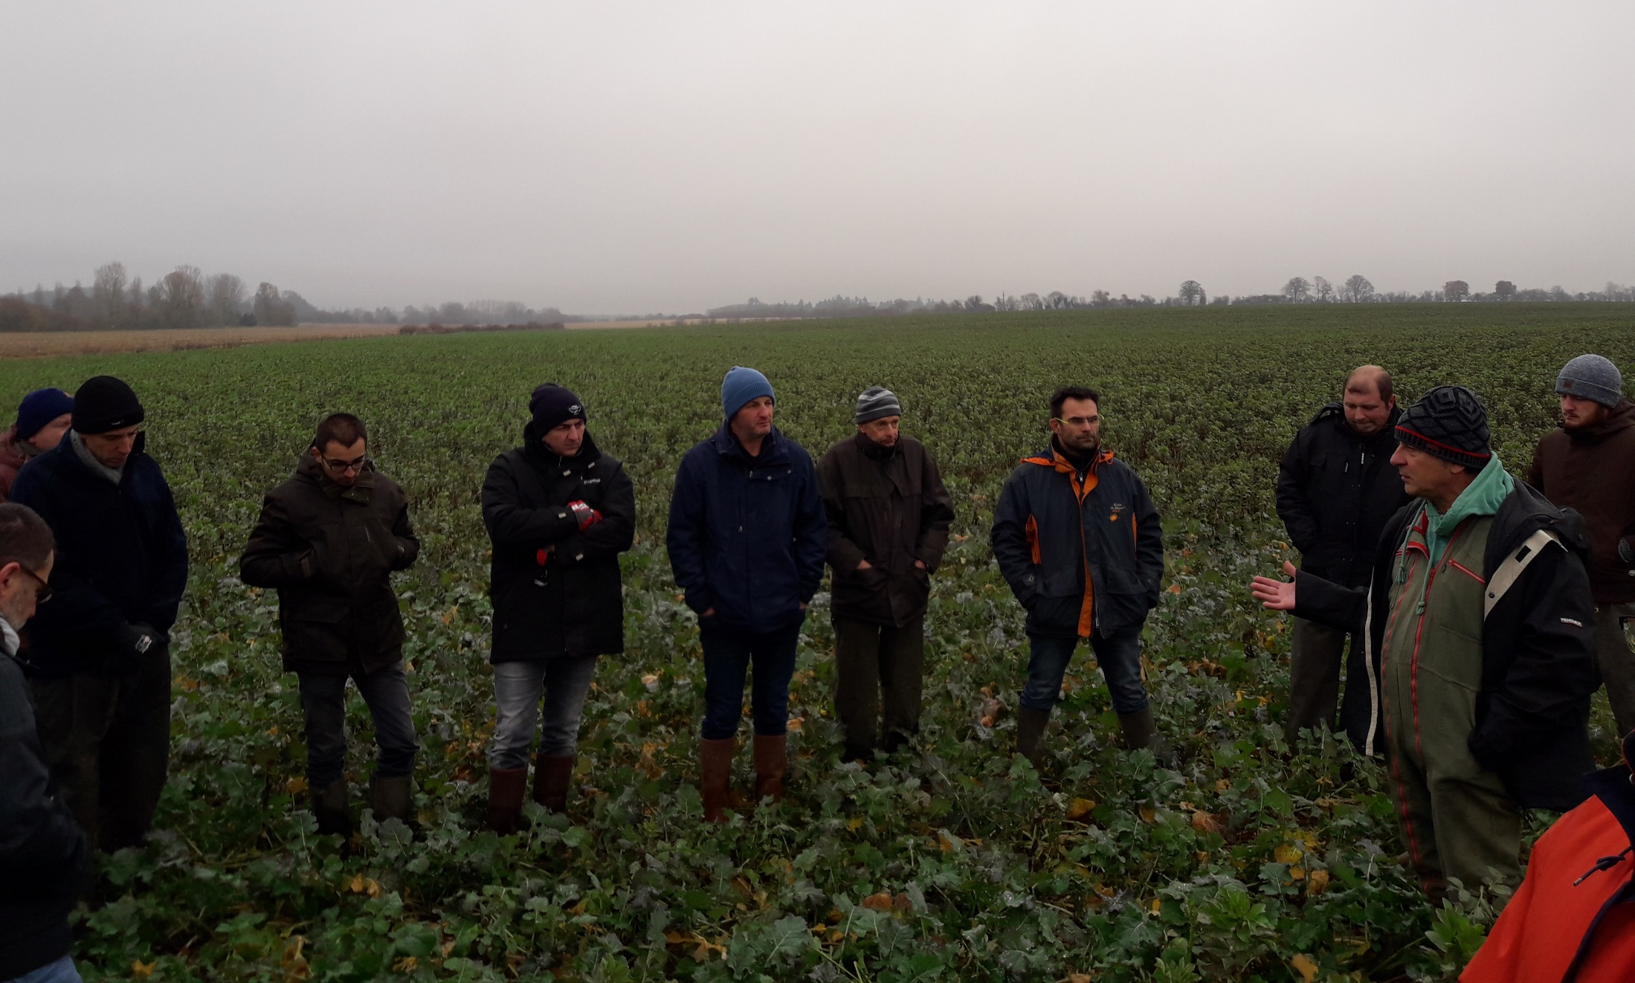
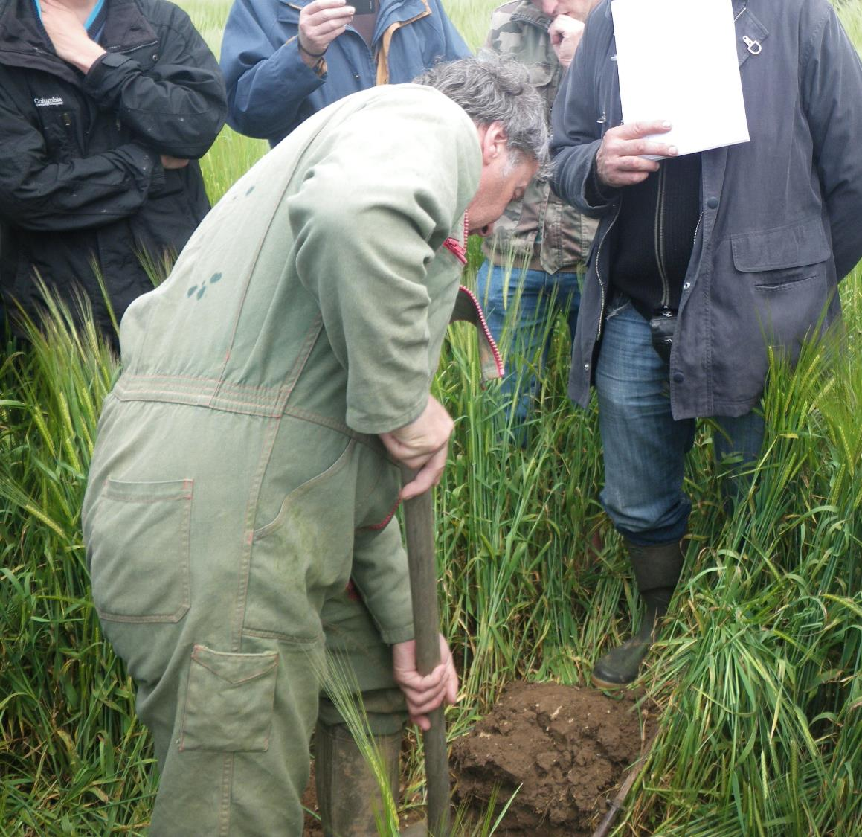
Example of implementation
Berry farmer’s network: how to promote winter oilseed rape robustness through a soil that facilitates the crop's mineral nutrition?
Visits to farmers’ fields to discuss cropping practices tested and results obtained
Test of innovative cultural practices (here direct drilling and intercropping with legumes)
Soil measurements (here soil structure assessment)

Slide 12
Discussion and conclusion

Slide 13
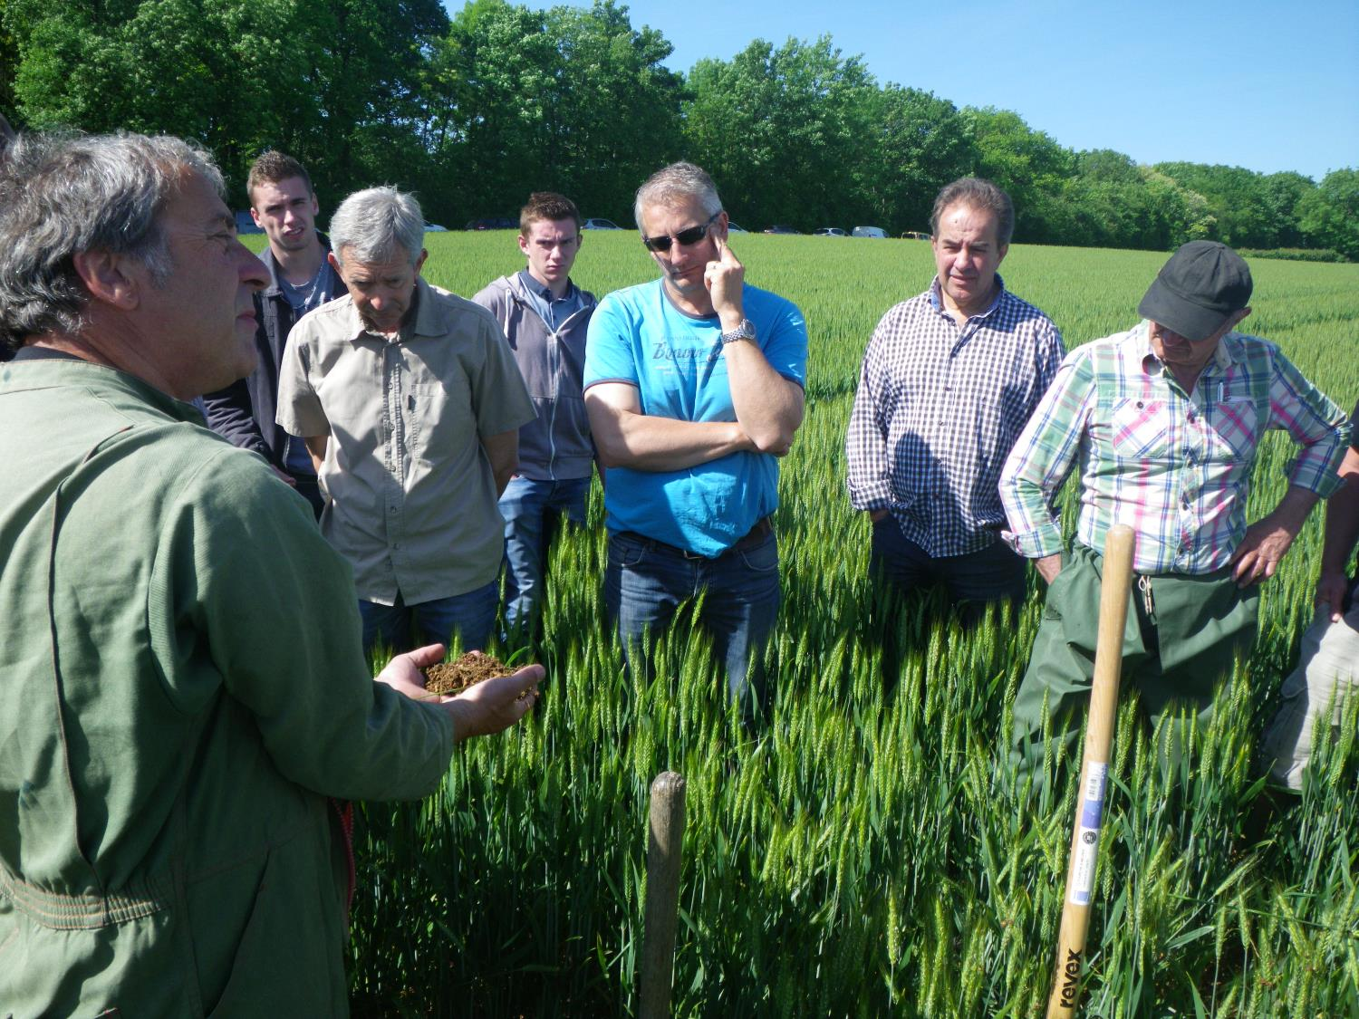
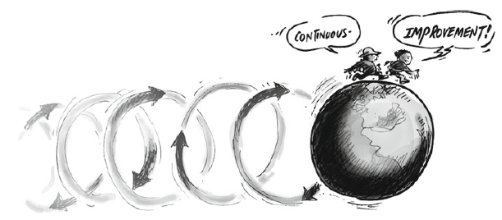
Dashboard & soil fertility
The dashboard is a strategic tool that supports step by step innovation design
Successful alignment with farmers’ soil fertility objectives
It is an effective way to help farmers manage and improve the fertility of their soils by:
  Focusing on benefits expected by farmers (rather than good cultural practices or improving the result of soil indicators)
  Shedding light on processes and simplifying complex interactions
  Proposing simple and accurate observation methods
  Encouraging iterative and adaptative management
Meynard et al. 2012

Slide 14
Thank you for your attention

