Slide 1
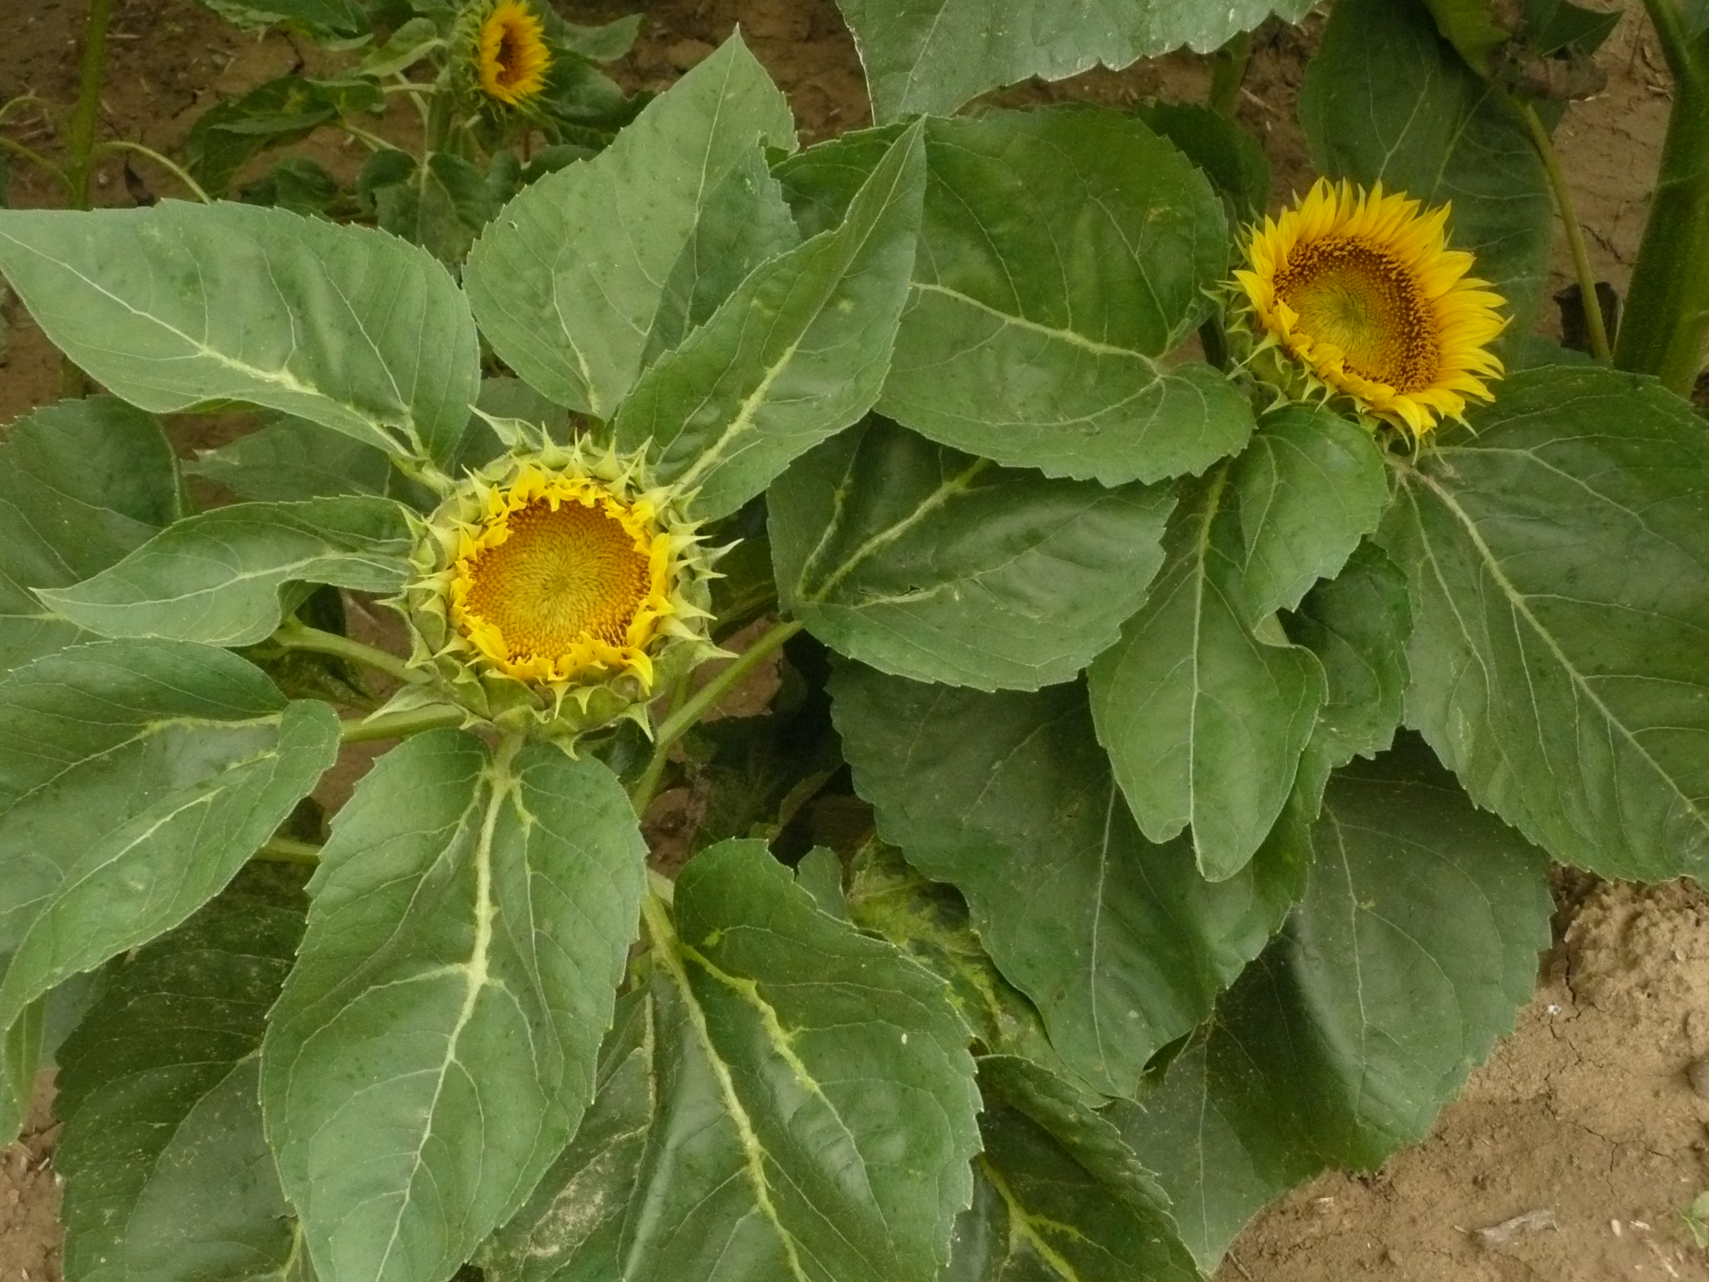
EVOLUTION OF SUNFLOWER DOWNY MILDEW IN FRANCE
Penaud Annette, Perrot Sophie, Boniface Marie-Claude,
Pauchet-Mattler Isabelle, Delos Marc & Bret-Mestries Emmanuelle
Notes:
Hello everyone,
I am going to present the results of the French sunflower downy mildew monitoring as well as some thoughts on the usefulness of this tool.
This work was carried out with the kind collaboration of GEVES, Inrae, the French Seed Association and the Ministry of Agriculture.
__________________________________________________________________________________________________________________________
Annette Penaud from Terres Inovia
Marie-Claude Boniface from the Inrae Laboratory of Plants Microbes and Environment Interactions in Toulouse
Sophie Perrot and her colleagues from the official pathology laboratory of the GEVES
Isabelle Pauchet-Mattler from the French Seed Association
and Marc Delos from the Ministry of Agriculture.

Slide 2
P. halstedii is monitored for 30 years in France
Professional organizations: seed production & certification, breeders, farmers, plant protection companies, Terres Inovia, Inrae, GEVES,…
Aims :
assess downy mildew pressure,
monitor the spread of existing pathotypes,
detect the emergence of new pathotypes,
monitor the evolution of strains resistant to fungicide seed treatment
Since 2019, P. halstedii no longer included in the list of quarantine pests but still regulated (NQRO, non-quarantine regulated organism)
→ ongoing monitoring !
Material & methods
Notes:
Sunflower downy mildew appeared in France fifty-five (55) years ago and has become widely established in the country. A monitoring system for this disease has existed for thirty (30) years, involving a whole range of organizations : seed production and certification actors, breeders, farmers, plant protection companies, Terres Inovia, Inrae, and the official pathology laboratory of the GEVES.
The aims of this survey are
to assess the downy mildew pressure,
to monitor the spread of existing pathotypes,
to detect the emergence of new pathotypes,
and to monitor the evolution of strains resistant to M-metalaxyl seed treatment.
Although no longer included in the list of quarantine pests since the end of twenty nineteen (2019) but still regulated (it is now classified as non-quarantine regulated organism), the monitoring of this biotrophic oomycete continues.

Slide 3
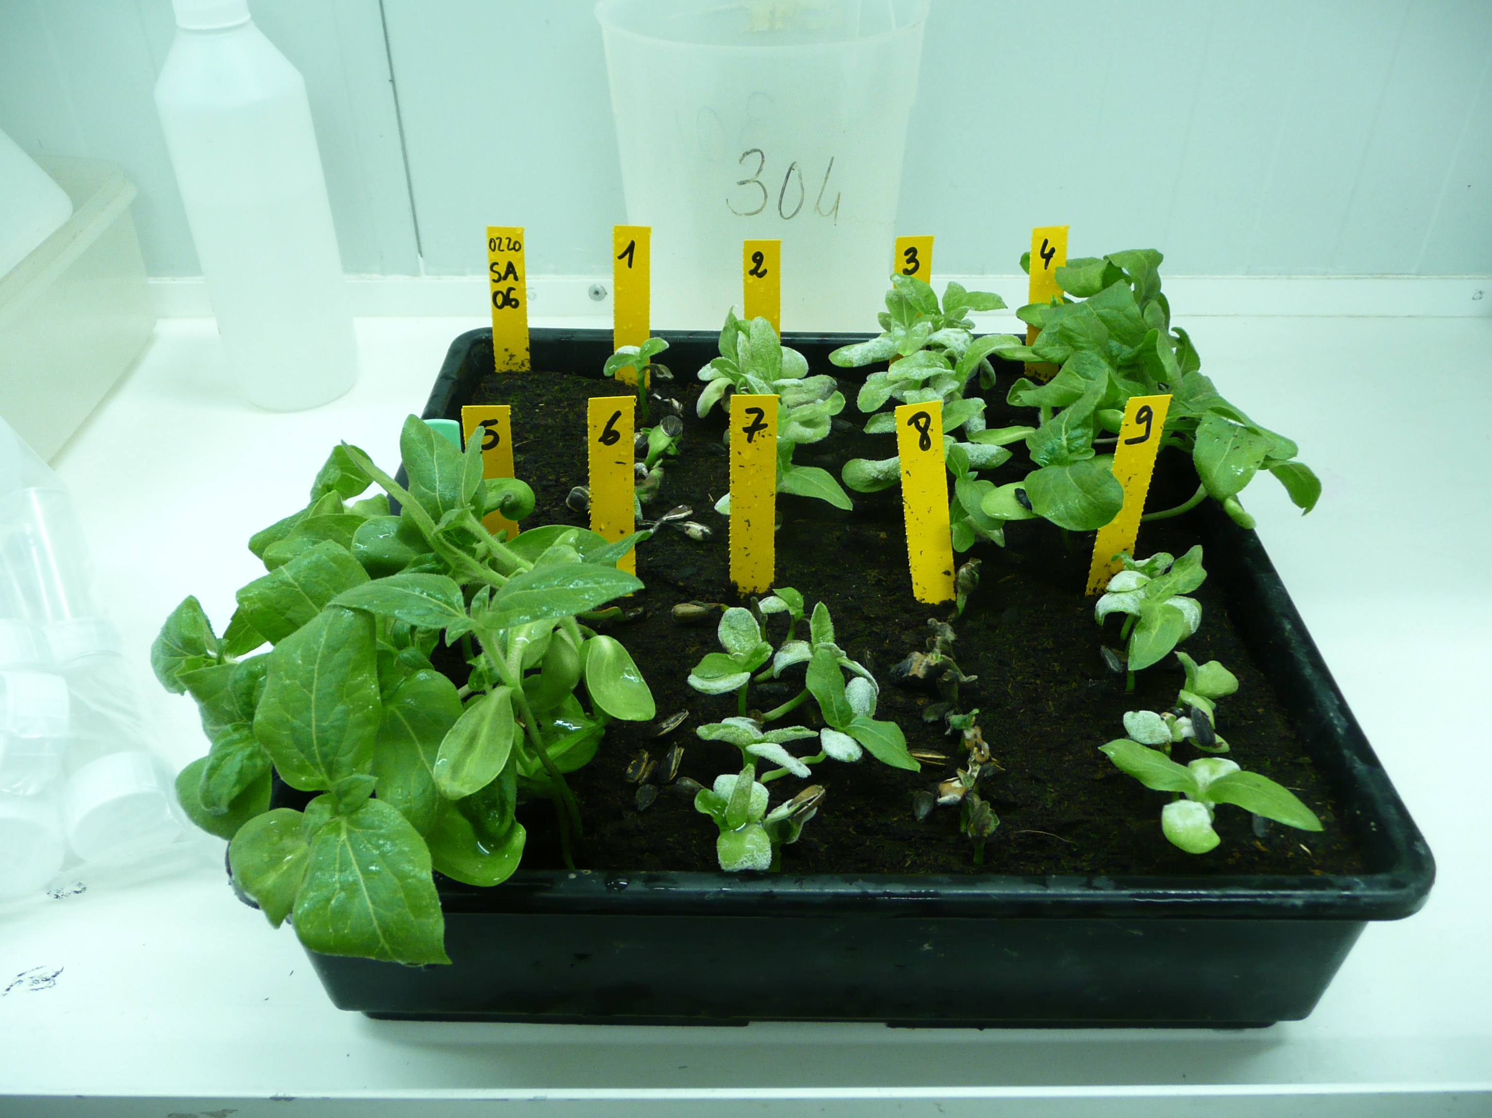
P. halstedii is monitored for 30 years in France
A survey on more than 500 plots on all sunflower cropping areas each year
Material & methods
20 to 50 isolates analyzed (mainly on resistant varieties)
Set of 9 differential lines (Tourvieille de Labrouhe et al., 2000)
+ 2 additional lines : RHA340 (Pl8) and PSC8 (Pl2)
10 seedlings / line
a 1-7 rating scale, to observe the type II responses (Mouzeyar et al., 1993)
Notes:
It is based on a field survey which aims to cover all sunflower production areas in the country. A minimum of five hundred (500) plots is required.
On each plot, the presence or absence of downy mildew is recorded.
Any attack on a variety expected to be resistant to the 9 pathotypes officially recognized in France with more than 10% of dwarfed plants is subject to a pathotype analysis. This analysis is carried out by the official pathology laboratory of the GEVES, using the international set of 9 differential lines. Two lines, with Pl8 and Pl2 genes were recently added to the set.
Ten seedlings are observed per differential line.
Symptoms are recorded on both cotyledons and the first pair of leaves and allows, using a 7-class scale, to observe the typically type II responses described by Mouzeyar el al.

Slide 4
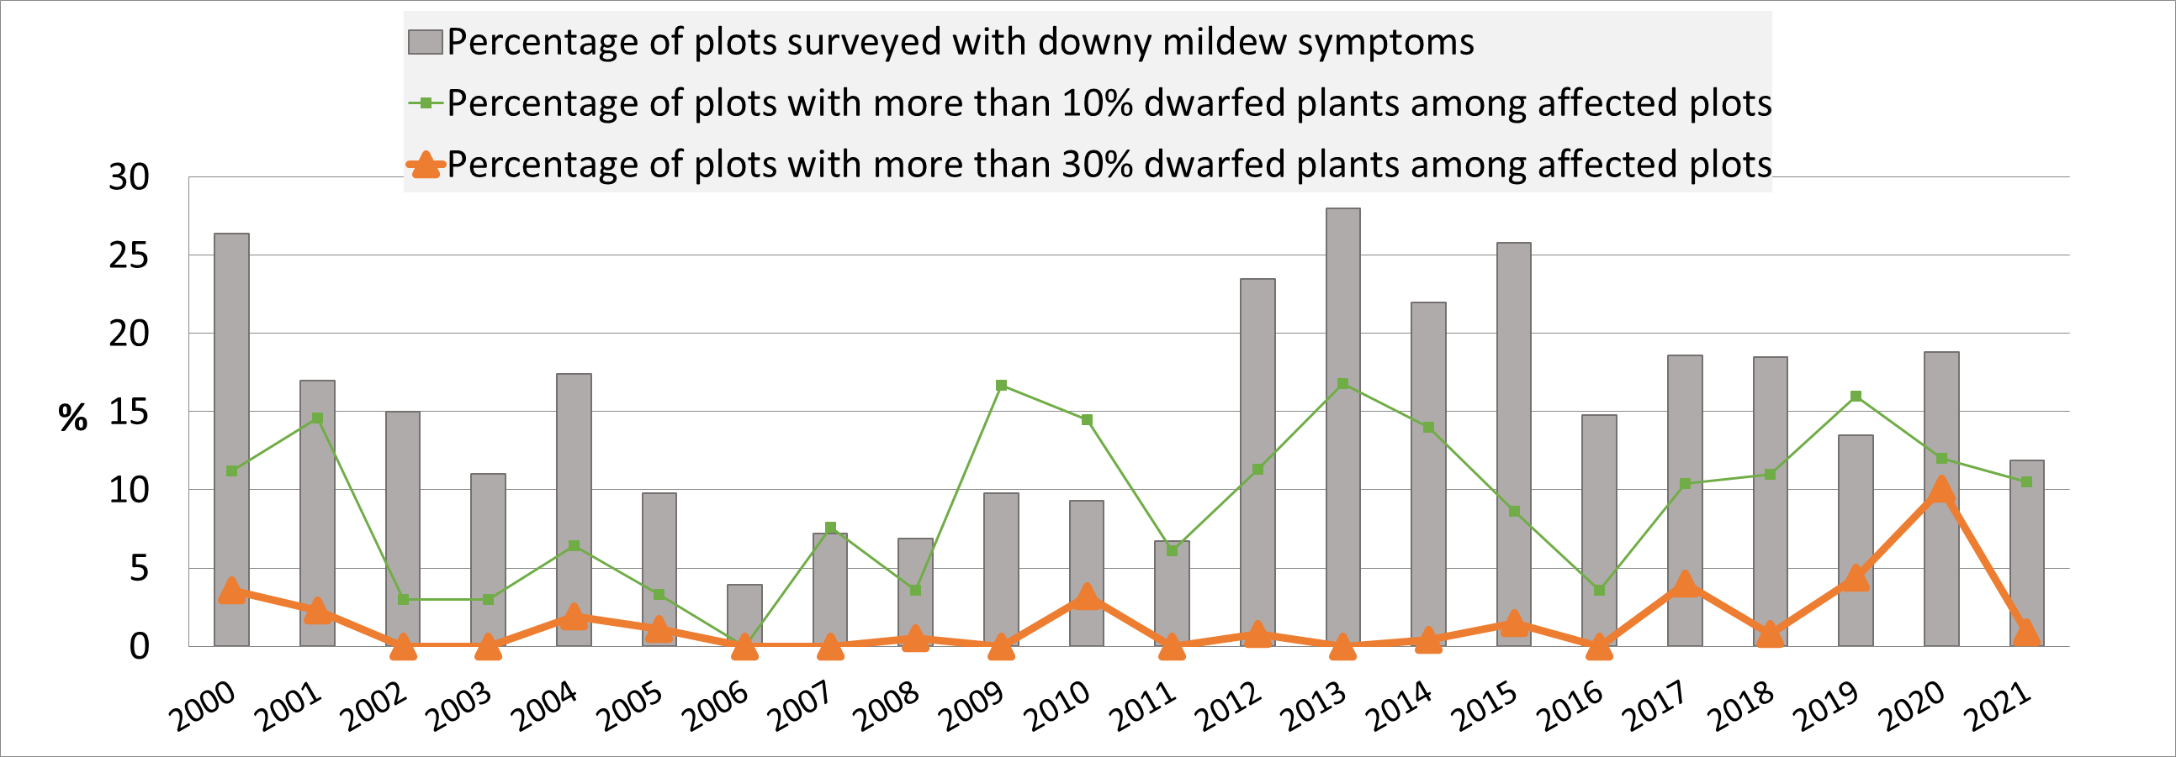
An overall well-controlled disease
2000-2021 : 860 plots observed / year
From 4 to 28% of infected fields, depending on spring weather conditions
Less than 10% of severe attacks (>30% dwarfed plants)
Results
(Terres Inovia)
Notes:
Since two thousand (2000), an average of eight hundred and sixty (860) sunflower fields have been observed each year.
The grey bars show that the percentage of infected fields ranges from four percent (4%) to twenty eight percent (28%) depending on the year, mainly due to the spring weather conditions.
The orange line shows that among the infected fields, less than ten percent (10%) were severely attacked, with more than thirty percent (30%) of dwarfed plants.

Slide 5
Since 2018, resistance overcoming of expected resistant varieties…
77 cases on 28 varieties resistant to 100, 304, 307, 314, 334, 703, 704, 710 & 714
% dwarfed plants : [10%-100%], mean=39%
Short crop rotations, intensive use of resistant varieties
Isolates of type « 334 », « 704 » and « 714 », some 714 isolates overcome Pl8 (cf. Martin-Sanz et al. 2020)
3 types of 714 overcoming isolates identified by GEVES
Results
Departments where resistance overcoming was observed from 2018 to 2021 (> 10% of dwarfed plants):
[number of cases; number of varieties concerned]
(Terres Inovia)
Probably several concomitant overcoming events
Notes:
The first cases of resistance overcoming of expected resistant varieties were observed in twenty eighteen.
In 4 years, seventy-seven (77) cases were recorded, on twenty-eight (28) varieties resistant to the 9 pathotypes officially recognized in France.
These cases are mainly located in the South-West of France, where the frequency of return of sunflower in the rotation is the shortest; however, a few cases have also been identified in two other regions (Poitou-Charentes and Center).
In the fields concerned, the percentage of dwarfed plants varies from ten to one hundred percent (10% to 100%), with an average of thirty nine percent (39%).
However, even if these cases are severe, they remain rare, considering the total area of sunflower crop in France (about seven hundred thousand hectares in twenty twenty one) and the wide range of varieties marketed in the country (about one hundred and eighty (180) each year).
In most of these situations, the fields concerned have been cultivated with varieties that probably have the same resistance gene or the same gene combination to control downy mildew.
This selection pressure is also linked to the explosion in the use of varieties resistant to the 9 pathotypes officially recognized in France, which increased by a factor of 3.5 between twenty thirteen (2013) and twenty seventeen (2017).
To date, the analysis of pathotypes responsible for these attacks provided profiles of type 334 (three three four), 704 (seven o four) or 714 (seven one four).
Most of these problematic isolates belong to pathotype 714 (seven one four) and can overcome the specific resistance gene Pl8.
This result agrees with the work of Martin-Sanz et al. (2020) on 3 isolates from South-West of France.
However, GEVES observed that 3 types of 714 (seven one four) overcoming isolates seem to exist regarding their virulence on Pl8 gene and their aggressiveness.
Considering also that we found problematic isolates related to pathotypes 334 (three three four) and 704 (seven o four), we think that probably several concomitant overcoming events are emerging in France.

Slide 6
These resistance overcoming phenomena affect many countries…
They require:
the expansion of the set of differential lines in a concerted way
(e.g., Ban et al., 2021; Gilley et al., 2020; Iwebor et al., 2021; Sedlárová et al., 2016; Tourvielle et al., 20212 ; Trojanová et al., 2018)
and the harmonization of the bio-testing protocol
(Trojanová et al., 2017; Spring, 2019)
Conclusions
They underline the key role of such monitoring:
For breeders
For producers
For researchers
Notes:
These resistance overcoming phenomena affect several countries, such as Italy, USA, Spain, but also Czech Republic, Russia,... and the set of 9 differential lines shows its limits for the identification of new pathotypes.
So, we need to expand this set in a concerted way, as underlined again recently by several teams around the world and we need also to harmonize as far as possible the way biological tests are carried out and symptoms observed, in order to secure the results of pathotype identification at international level.
These events underline also the key role of such monitoring of this particularly changing pathogen, not only in France but also in all sunflower-growing countries:
For breeders, for monitoring the efficiency of the genetic solutions they proposed and for anticipating needs
For producers, for the knowledge of locally present pathotypes and the ability to understand the advice on alternating varieties
And finally for researchers, for focusing the research work on genetics of sunflower resistance and understanding the evolution of virulence of Plasmopara.

Slide 7
Different research topics on both sunflower & P. halstedii to initiate or to reinforce
Modes of action of Pl genes and optimization of their exploitation
Understanding the evolutionary mechanisms of the pathogen (virulence, fungicide resistance)
Perspectives
Impacts of the simultaneous use of genetic and chemical protection
Quantitative resistance
Impact of climate change on downy mildew.
Notes:
These results reinforce the need to initiate or continue targeted research on different topics on both sunflower and P. halstedii:
- The knowledge of the modes of action of specific resistance genes and the optimization of their exploitation would contribute to optimize pyramiding solutions.
- understanding the evolutionary mechanisms of the pathogen, through knowledge of the Plasmopara halstedii genome and research into the determinants of virulence are topics that deserve to be further investigated; the emergence of fungicide-resistant populations, as well as the impacts of the simultaneous use of genetic and chemical protection on the pathogen, should also be included in research programs.
- the quantitative resistance of sunflower to downy mildew appears more than ever to be a major lever for the long-term control of the disease and work on this topic deserves to continue, on both the identification of the genes involved and the development of operational protocols for the phenotypic evaluation of this resistance in controlled conditions.
- And finally, we need to study the impact of climate change on this pathogen which is associated with the evolution of sunflower growing areas.

Slide 8
An idea…
Organization of a working meeting dedicated to downy mildew:
To share informations on recent resistance overcoming events
To define an enlarged and shared differential set at the international level
To work on the nomenclature of Pl genes
Videoconference
Let me know if you’re interested in being an active participant !
Perspectives
See you at the poster session!
Notes:
Finally, we would like to propose to organize a working meeting dedicated to downy mildew, with the following objectives :
- To share informations on recent resistance overcoming events
- To define an enlarged and shared differential set at the international level
- To work on the nomenclature of Pl genes.
We could consider it at the end of this year or the beginning of next year, by videoconference
So let me know if you’re interested in being an active participant during the poster session !

Slide 9
Thank you for your attention !
Notes:
Thank you all for your attention.
I would like to take this opportunity to thank in a special way my colleague from Terres Inovia, Annette Penaud, who retired a few months ago and who shared with me all her long experience on sunflower downy mildew monitoring.

