Slide 1




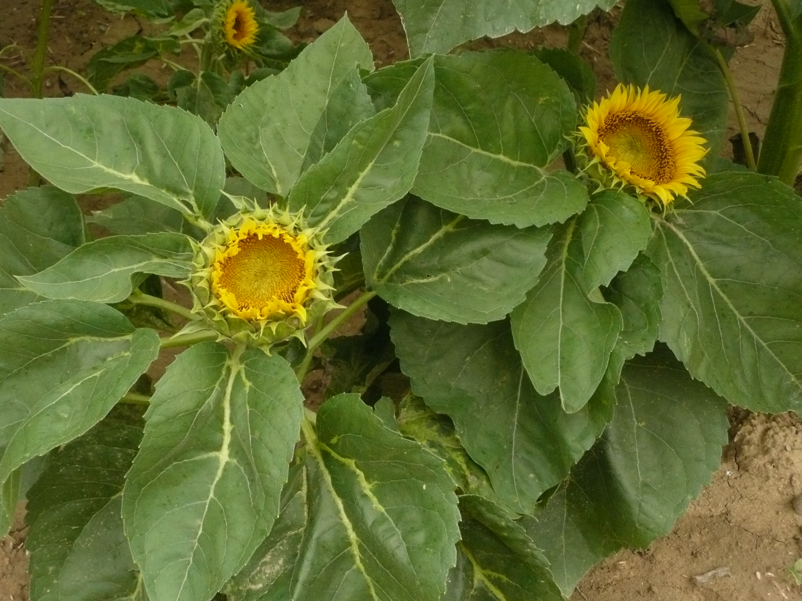
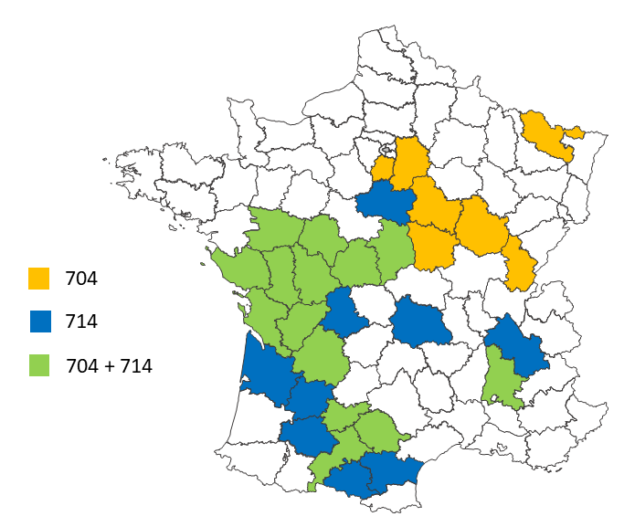
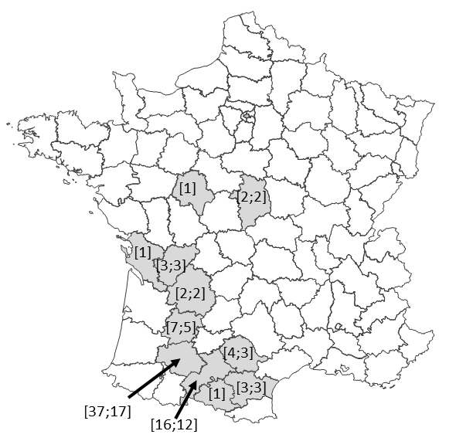


Evolution of sunflower downy mildew in France
Penaud Annette¹, Perrot Sophie², Boniface Marie-Claude³, Pauchet-Mattler Isabelle⁴, Delos Marc⁵ & Bret-Mestries Emmanuelle¹
¹ Terres Inovia, 1 avenue Lucien Brétignières, 78850 Thiverval-Grignon, France
² GEVES, rue Georges Morel, 49071 Beaucouzé cedex, France
³ INRAE-LIPME, Chemin de Borde Rouge – Auzeville, CS 52627, 31326 Castanet-Tolosan cedex, France
⁴ UFS, 17 rue du Louvre, 75001 Paris, France
⁵ DRAAF- SRAl, Cité Administrative- Bat E, Bd Armand Duportal, 31074 TOULOUSE cedex, France.
Since its first discovery in France in 1966, sunflower downy mildew, caused by Plasmopara halstedii, has become widely established in the country. Although no longer included in the list of quarantine pests since the end of 2019 but still regulated (now classified as NQRO, non-quarantine regulated organism), the monitoring of this biotrophic oomycete continues. It provides the basis for the development of integrated pest management recommendations for producers and for the orientation of breeding and research efforts.
Terres Inovia
An annual field survey, in all production areas, before flowering, on a minimum of 500 plots
An analysis by biological test of the pathotypes for any variety expected to be resistant to the 9 pathotypes officially recognized in France (100, 304, 307, 314, 334, 703, 704, 710 and 714) and attacked at more than 10% (GEVES laboratory)
Differential host set of 9 lines defined by Tourvieille et al. (2000) + RHA340 (Pl8) and PSC8 (Pl2) recently added
Symptoms scoring in 7 classes according to Mouzeyar et al. (1993)
Until 2020, evaluation of the resistance to metalaxyl-M of each downy mildew isolate.
Since 2000, 860 parcelles observed each year on average (from 566 to 1160)
From 4 to 28% of infected fields, according to spring weather conditions
Among the infected fields, 0 to 10% of fields showing more than 30% of dwarfed plants
From 20 to 50 isolates analyzed each year, prevalence of pathotypes 704 and 714 detected for the first time in 2002 -------------------------------------------------------------------->
Resistance to metalaxyl-M (only fungicide authorized until 2021 and used on 85% of the sunflower crop each year): widespread, including recent isolates.
Map of the prevalence of pathotypes 704 and 714 in France in 2020 since their appearance in 2002 (Terres Inovia)
Resistance overcoming of expected resistant varieties (100, 304, 307, 314, 334, 703, 704, 710 & 714):
  Since 2018, 77 cases on 28 varieties, mainly in the South-West
  From 10% to 100% of dwarfed plants, 39% on average
  Causes: short rotations, intensive use of resistant varieties, with only one Pl gene
  Isolates of type 334, 704 and 714; some 714 isolates overcome Pl8 (cf. Martin-Sanz et al., 2020)
  3 types of 714 overcoming isolates identified by GEVES, suggesting several concomitant overcoming events.
<---
Departments where resistance overcoming was observed from 2018 to 2021 (more than 10% of dwarfed plants) : [number of cases; number of varieties concerned] (Terres Inovia)
Many countries are concerned, requiring expansion and adaptation of the differential host set (e.g., Ban et al., 2021; Gilley et al., 2020; Iwebor et al., 2021; Sedlárová et al., 2016; Trojanová et al., 2018) and the harmonization of the bio-testing protocol (Trojanová et al., 2017; Spring, 2019).
These reinforce the need to initiate or continue targeted research on different topics on both sunflower and P. halstedii:
Mode of action of Pl genes and optimization of their exploitation
Understanding the evolutionary mechanisms of the pathogen (virulence, fungicide resistance)
Impacts of the simultaneous use of genetic and chemical protection
Quantitative resistance
Impact of climate change on downy mildew.
References
Bán, R., Kovács, A., Nisha, N., Pálinkás, Z., Zalai, M., Yousif, A.I.A., and K. Körösi. 2021.. J. Fungi 7:549 https://doi.org/10.3390/jof7070549.
Sedlárová, M., PospíchBán, R., Kovács, A., Nisha, N., Pálinkás, Z., Zalai, M., Yousif, A.I.A., and K. Körösi. 2021. J. Fungi 7:549 https://doi.org/10.3390/jof7070549.
Gilley, M.A., Gulya, T.J., Seiler, G.J., Underwood, W., Hulke, B.S., Misar, C.G., and S.G. Markell. 2020. Plant Disease 104:2823–2831 https://doi.org/10.1094/PDIS-10-19-2063-RE.
Iwebor, M., Antonova, T., Araslanova, N., Saukova, S., Pitinova, Y., Eliseeva, K., and A. Belorutskyi. 2021. Plant Protection Science 58:76-80 https://doi.org/10.17221/85/2021-PPS.
Martín-Sanz, A., Rueda, S., García-Carneros, A.B., and L. Molinero-Ruiz. 2020. Plant Dis :104:597.
Mouzeyar, S., Tourvieille, D., and F. Vear, 1993. J. Phytopathology 139:289-297.
Tourvieille de Labrouhe, D., Gulya, T. J., Masirevic, S., Penaud, A., Rashid, K.Y., and F. Virányi. 2000. In: Proc. 15th Int. Sunfl. Conf., Toulouse, France. Int. Sunfl. Assoc., Paris, France.
Trojanová, Z., Sedlářová, M., Gulya, T.J., and A. Lebeda. 2017. Plant Pathology 66:171-185 Doi:10.1111/ppa.12593.
Trojanová, Z.D., Sedlářová, M., Pospichalová, R., and A. Lebeda. 2018. Plant Pathology 67:113-144 DOI: 10.1111/ppa.12722.
20th International Sunflower Conference, June 20-23 2022, Novi Sad, Serbia

Slide 2

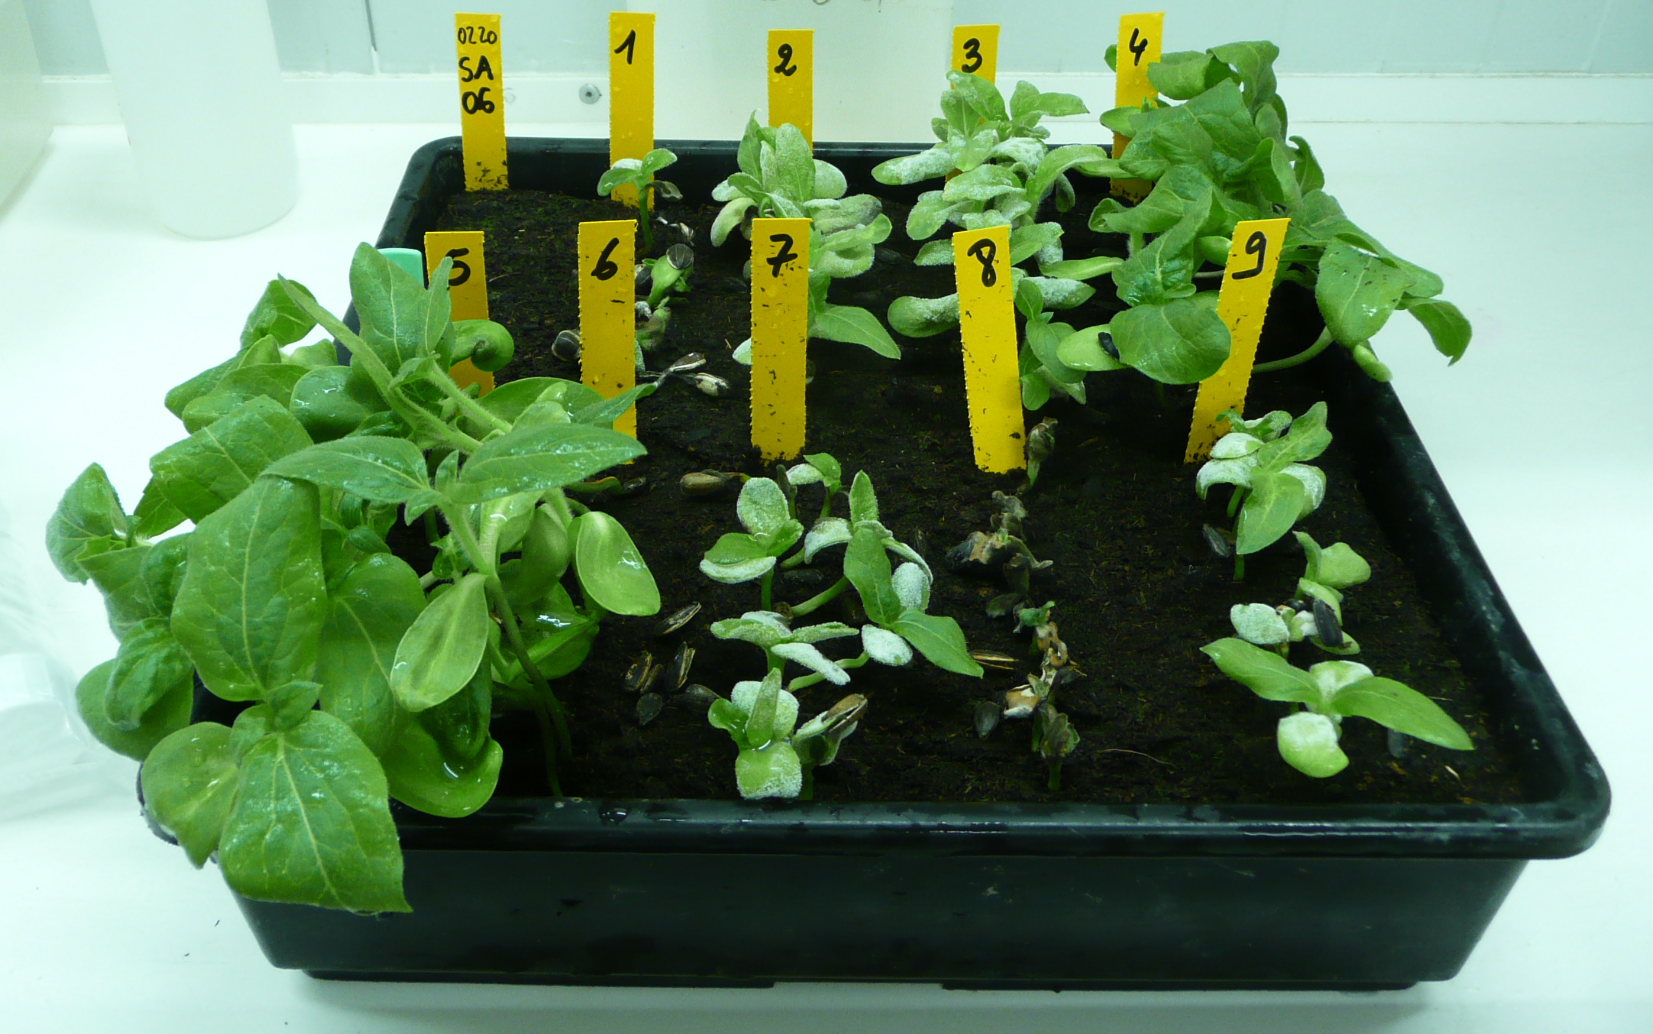
Development of molecular markers to identify sunflower downy mildew races
Bret-Mestries Emmanuelle¹, Boniface Marie-Claude², Legendre Alexandra², Legrand Ludovic², Perrot Sophie³, Robert Aurélie³, Levêque Thomas³, Damico Isabela¹, Carpezat Julien¹, Penaud Annette¹, Pecrix Yann², Godiard Laurence², Vear Felicity² & Muños Stéphane²
¹ Terres Inovia, 1 avenue Lucien Brétignières, 78850 Thiverval-Grignon, France
² INRAE-LIPME, Chemin de Borde Rouge – Auzeville, CS 52627, 31326 Castanet-Tolosan cedex, France
³ GEVES, rue Georges Morel, 49071 Beaucouzé cedex, France.
Plasmopara halstedii is a biotrophic pathogen evolving rapidly (12 pathotypes appeared in France between 2000 and 2015). The sustainable management of this pathogen is based on the knowledge of the pathotypes present on the territory thanks to an epidemiological monitoring system. Over the last three years, harmful attacks on varieties previously resistant to all the pathotypes officially recognized in France (100, 304, 307, 314, 334, 703, 704, 710 and 714) occurred; these resistance overcoming events are also observed in other countries (e.g., Martin-Sanz et al., 2020).
Terres Inovia
This work has two complementary objectives :
contribute to broaden the current international set of 9 differential lines used for biological testing (Tourvieille de Labrouhe et al., 2000).
develop molecular markers for pathotypes identification.
Two complementary PCR-based approaches have been used for the development of molecular markers:
High resolution melting (HRM) analysis
Kompetitive Allele-Specific PCR (KASPar) technology.
Design of InDel & SNP markers
Marker test
Marker validation
Genome sequence of 17 pathotypes, new polymorphism analysis
A set of 13 CASP (Cleaved Amplified Polymorphic Sequence) markers based on pathogenicity effectors
(Gascuel et al., 2016; Godiard, 2018; Pecrix et al., 2019)
17 reference pathotypes
Check of their specificity for P. halstedii
78 isolates mainly from the French monitoring (100, 300, 304, 307, 314, 330, 334, 700, 703, 704, 707, 710, 714, 717, 730, 774)
DNA from spores & infected cotyledons
Preliminary results:
A set of 7 HRM markers, ready to identify the 17 known pathotypes
13 KASPar markers are specific to 13 pathotypes.
In progress:
Validation of these markers on isolates from the 2022 French monitoring
Search for new markers based on the sequences of 9 new downy mildew genomes to characterize the overcoming isolates not currently identified.
Promising first results
Multiple applications at national and international level
Easier identification of downy mildew pathotypes : safer, faster, cheaper
An evolving method: design of new markers faster handling of new virulences
Increased monitoring of the territory and more relevant advice to producers
Opportunities for new R&D projects in public-private partnership
Identification of genes involved in the virulence of downy mildew races, understanding of the evolution of pathotypes
Screening of downy mildew populations present in breeding nurseries; monitoring the effectiveness of sunflower resistance genes
Anticipating the deployment of new resistance gene combinations in the field.
This work has been granted by Plant2Pro® Carnot Institute in the frame of its 2020 call for projects.
Plant2Pro® is supported by ANR (agreement #20 CARN 002401).
References
Gascuel Q., Bordat A., Sallet E., Pouilly N., Carrere S., Roux F., Vincourt P., Godiard L. 2016. PLoS ONE 11(2): e0148513.
Godiard, 2018. PROMOSOL.
Martín-Sanz, A., Rueda, S., García-Carneros, A.B., and L. Molinero-Ruiz. 2020. Plant Dis :104:597.
Pecrix Y., Buendia L., Penouilh-Suzette C., Maréchaux M., Legrand L., Bouchez O., Rengel D., Gouzy J., Cottret L., Vear F., Godiard L. 2019. The Plant Journal doi : 101111/tpj.14157
Tourvieille de Labrouhe, D., Gulya, T. J., Masirevic, S., Penaud, A., Rashid, K.Y., and F. Virányi. 2000. In: Proc. 15th Int. Sunfl. Conf., Toulouse, France. Int. Sunfl. Assoc., Paris, France.
20th International Sunflower Conference, June 20-23 2022, Novi Sad, Serbia
Notes:
Two complementary PCR-based approaches have been used for the development of molecular markers :
High resolution melting (HRM) analysis
Competitive Allele-Specific PCR (KASPar) technology.
The design of the InDel and SNP markers was based on the sequenced genome of 17 pathotypes and whose polymorphism was again analyzed. It also used a previously developed set of 13 CASP (Cleaved Amplified Polymorphic Sequence) markers based on pathogenicity effectors (Gascuel et al., 2016; Godiard, 2018; Pecrix et al., 2019).
The markers were tested on 17 reference pathotypes and validated on a total of 78 isolates mainly from the territory’s monitoring (100, 300, 304, 307, 314, 330, 334, 700, 703, 704, 707, 710, 714, 717, 730, 774)

